Slide 1

ME23312 ENGINEERING THERMODYNAMICS
Unit III – Properties of Pure Substance · Presentation 5 of 10
The p–v, T–v, T–s and h–s (Mollier) Diagrams
The saturation dome and isotherms · the T–v diagram · the T–s diagram as the working diagram for second-law analysis · the Mollier chart and its lines · reading the diagrams
Dr. Anantha Raman L., M.E., Ph.D. · Associate Professor, Department of Mechanical Engineering, Rajalakshmi Institute of Technology, Chennai

Slide 2

In this presentation
The p–v diagram
Isotherms on the p–v plane
The T–v diagram
The T–s diagram
The h–s (Mollier) chart
Lines drawn on the Mollier chart
Reading the diagrams
ME23312 Engineering Thermodynamics · Unit III · Presentation 5
2

Slide 3
The p–v and T–v diagrams
1
ME23312 Engineering Thermodynamics · Unit III · Presentation 5
3

Slide 4
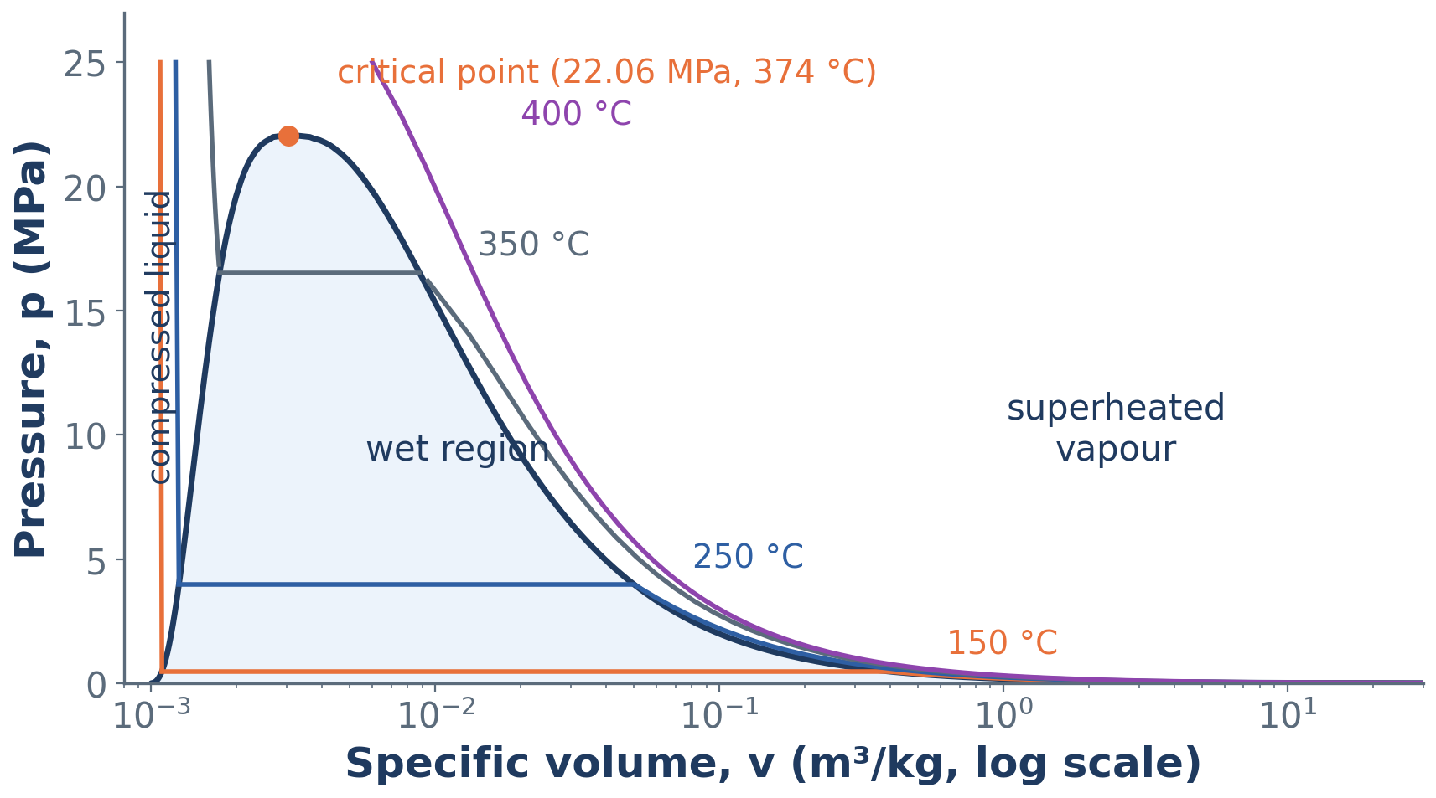
The p–v diagram of water with isotherms
The liquid–vapour region is a dome bounded by the saturated liquid and saturated vapour lines, meeting at the critical point
ME23312 Engineering Thermodynamics · Unit III · Presentation 5
4

Slide 5
Isotherms on the p–v plane
Cross the dome horizontally – constant pressure during vaporisation
Fall steeply in the liquid region – a liquid is almost incompressible
Follow a hyperbola-like curve in the vapour region, approaching pv = RT at low pressures
The critical isotherm has a horizontal point of inflexion at the critical point
KEY POINT The triple line is the horizontal base of the dome.
ME23312 Engineering Thermodynamics · Unit III · Presentation 5
5

Slide 6
The T–v diagram
The same picture with constant-pressure lines instead of isotherms (Presentation 2)
Isobars run horizontally through the dome and rise steeply in the liquid and vapour regions
The horizontal segment shortens as the pressure rises and vanishes at the critical point
ME23312 Engineering Thermodynamics · Unit III · Presentation 5
6

Slide 7
The T–s diagram
2
ME23312 Engineering Thermodynamics · Unit III · Presentation 5
7

Slide 8
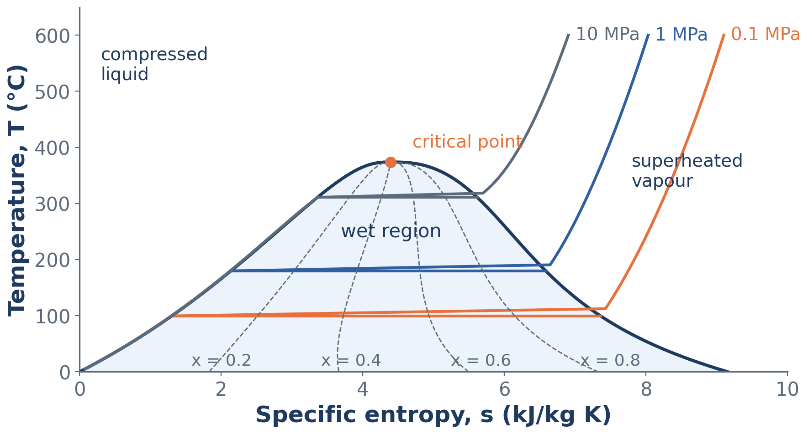
The T–s diagram of water
Saturation dome, isobars at 0.1, 1 and 10 MPa, and lines of constant dryness fraction
ME23312 Engineering Thermodynamics · Unit III · Presentation 5
8

Slide 9
Features of the T–s diagram
The working diagram for second-law analysis: area under a reversible process = heat transferred; isentropic process = vertical line
Inside the dome constant-pressure lines coincide with the isotherms
In the liquid region isobars rise steeply, almost along the saturated liquid line; in the superheated region they curve upwards
Lines of constant dryness fraction divide the horizontal segments of the dome in proportion
KEY POINT Datum: s = 0 for saturated liquid at the triple point.
ME23312 Engineering Thermodynamics · Unit III · Presentation 5
9

Slide 10
The h–s (Mollier) chart
3
ME23312 Engineering Thermodynamics · Unit III · Presentation 5
10

Slide 11
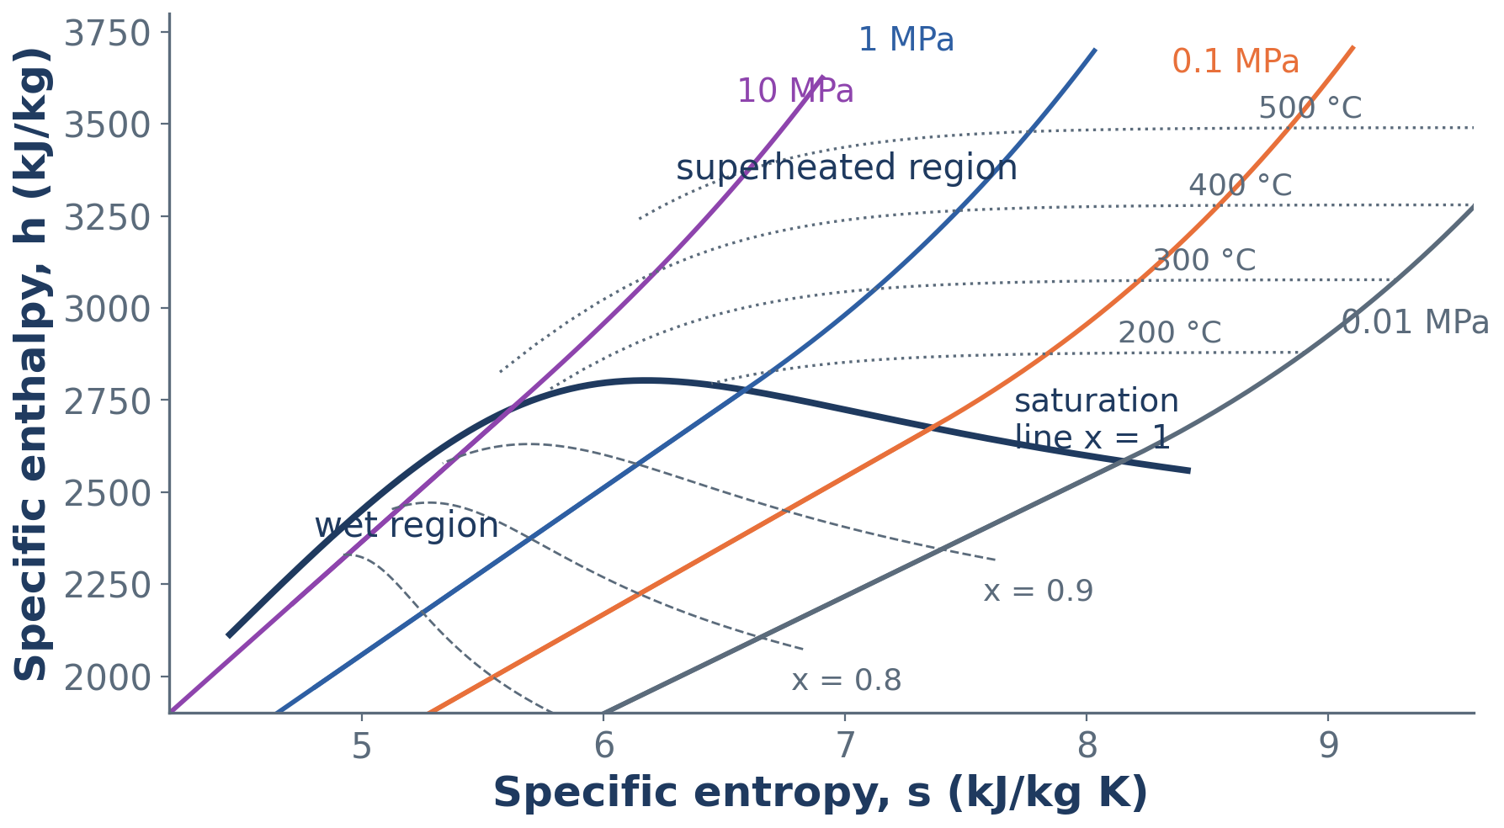
The h–s (Mollier) diagram for steam
Only the region of engineering interest is drawn: x above about 0.6 and pressures from about 0.01 to 100 MPa
ME23312 Engineering Thermodynamics · Unit III · Presentation 5
11

Slide 12
Why the Mollier chart is used for flow calculations
Enthalpy drop in a turbine or nozzle for an isentropic process = a vertical distance
End state after throttling lies on a horizontal line (h = constant)
Both can be read directly – no interpolation in tables
ME23312 Engineering Thermodynamics · Unit III · Presentation 5
12

Slide 13
Lines drawn on the Mollier chart
Line | Behaviour
Constant pressure | Straight in the wet region (dh/ds = T at constant p); curving upwards in the superheated region
Constant temperature | Superheated region only; bend towards the horizontal as pressure falls – ideal-gas behaviour, h = f(T)
Constant dryness fraction | Wet region
Constant specific volume | Steeper than the isobars
Saturation line x = 1 | Separates the wet and superheated regions; the critical point lies far down on the left
ME23312 Engineering Thermodynamics · Unit III · Presentation 5
13

Slide 14
Reading the diagrams
Inside the dome p and T are not independent – an isobar and an isotherm are the same horizontal line – so a second property (v, h, s or x) is required to fix the state.
Outside the dome (compressed liquid, superheated vapour) p and T are independent and fix the state on their own
ME23312 Engineering Thermodynamics · Unit III · Presentation 5
14

Slide 15
Summary
p–v: saturation dome; isotherms horizontal inside, steep in the liquid, hyperbola-like in the vapour
T–v: the same dome with isobars
T–s: heat = area, isentropic = vertical; isobars coincide with isotherms inside the dome
Mollier h–s: isentropic = vertical drop, throttling = horizontal line
Chart lines: p, T (superheated), x, v, and the saturation line x = 1
Inside the dome a second property is needed; outside, p and T suffice
ME23312 Engineering Thermodynamics · Unit III · Presentation 5
15

Slide 16
Next: The steam tables
Saturation tables (temperature and pressure basis), superheat table, compressed-liquid table
Interpolation and identifying the state
Steam as a real gas
ME23312 Engineering Thermodynamics · Unit III · Presentation 5
16

